Slide 1
POC- Employee Management System Smita Shrivastava Ajay Upadhyay Vivek Chaurasia
Team Members:

Slide 2
Contents
Tech Stacks
Functionality Overview
Modules
Architecture Diagram
Sequence Diagram
Outputs
Learnings

Slide 3
Tech Stack
Application server – Apache Tomcat(embedded)
MySQL Workbench (Version - 8.0)​
Spring Boot (Version - 2.5)​
Microservices
IntelliJ Idea IDE​
Postman(Version-10.18.10)
JDK (Version - 1.8)​
Spring Data JPA

Slide 4
Functionality Overview
Employee Management System
This project is based on managing Employee through web application by using Java, Spring Boot, Microservices, MySQL and Hibernate. The main goal of this project is to create a microservices architecture to communicate different services with each other by using different techniques(Feign, RestTemplate, WebSocket).
The system includes Employee Service where user can register employee details. Department Services where user can register their department details from the list of departments and Organization Service where user can select the organization where he is engaged. Here we are using microservices to make these services independent with each other.
Implemented Circuit Breaker, Resilience4j to avoid fault tolerance between services.

Slide 5
Modules
Employee Service Module
Department Service Module
Organization Service Module
API Gateway Module
Config Server Module
Eureka Server Module

Slide 6
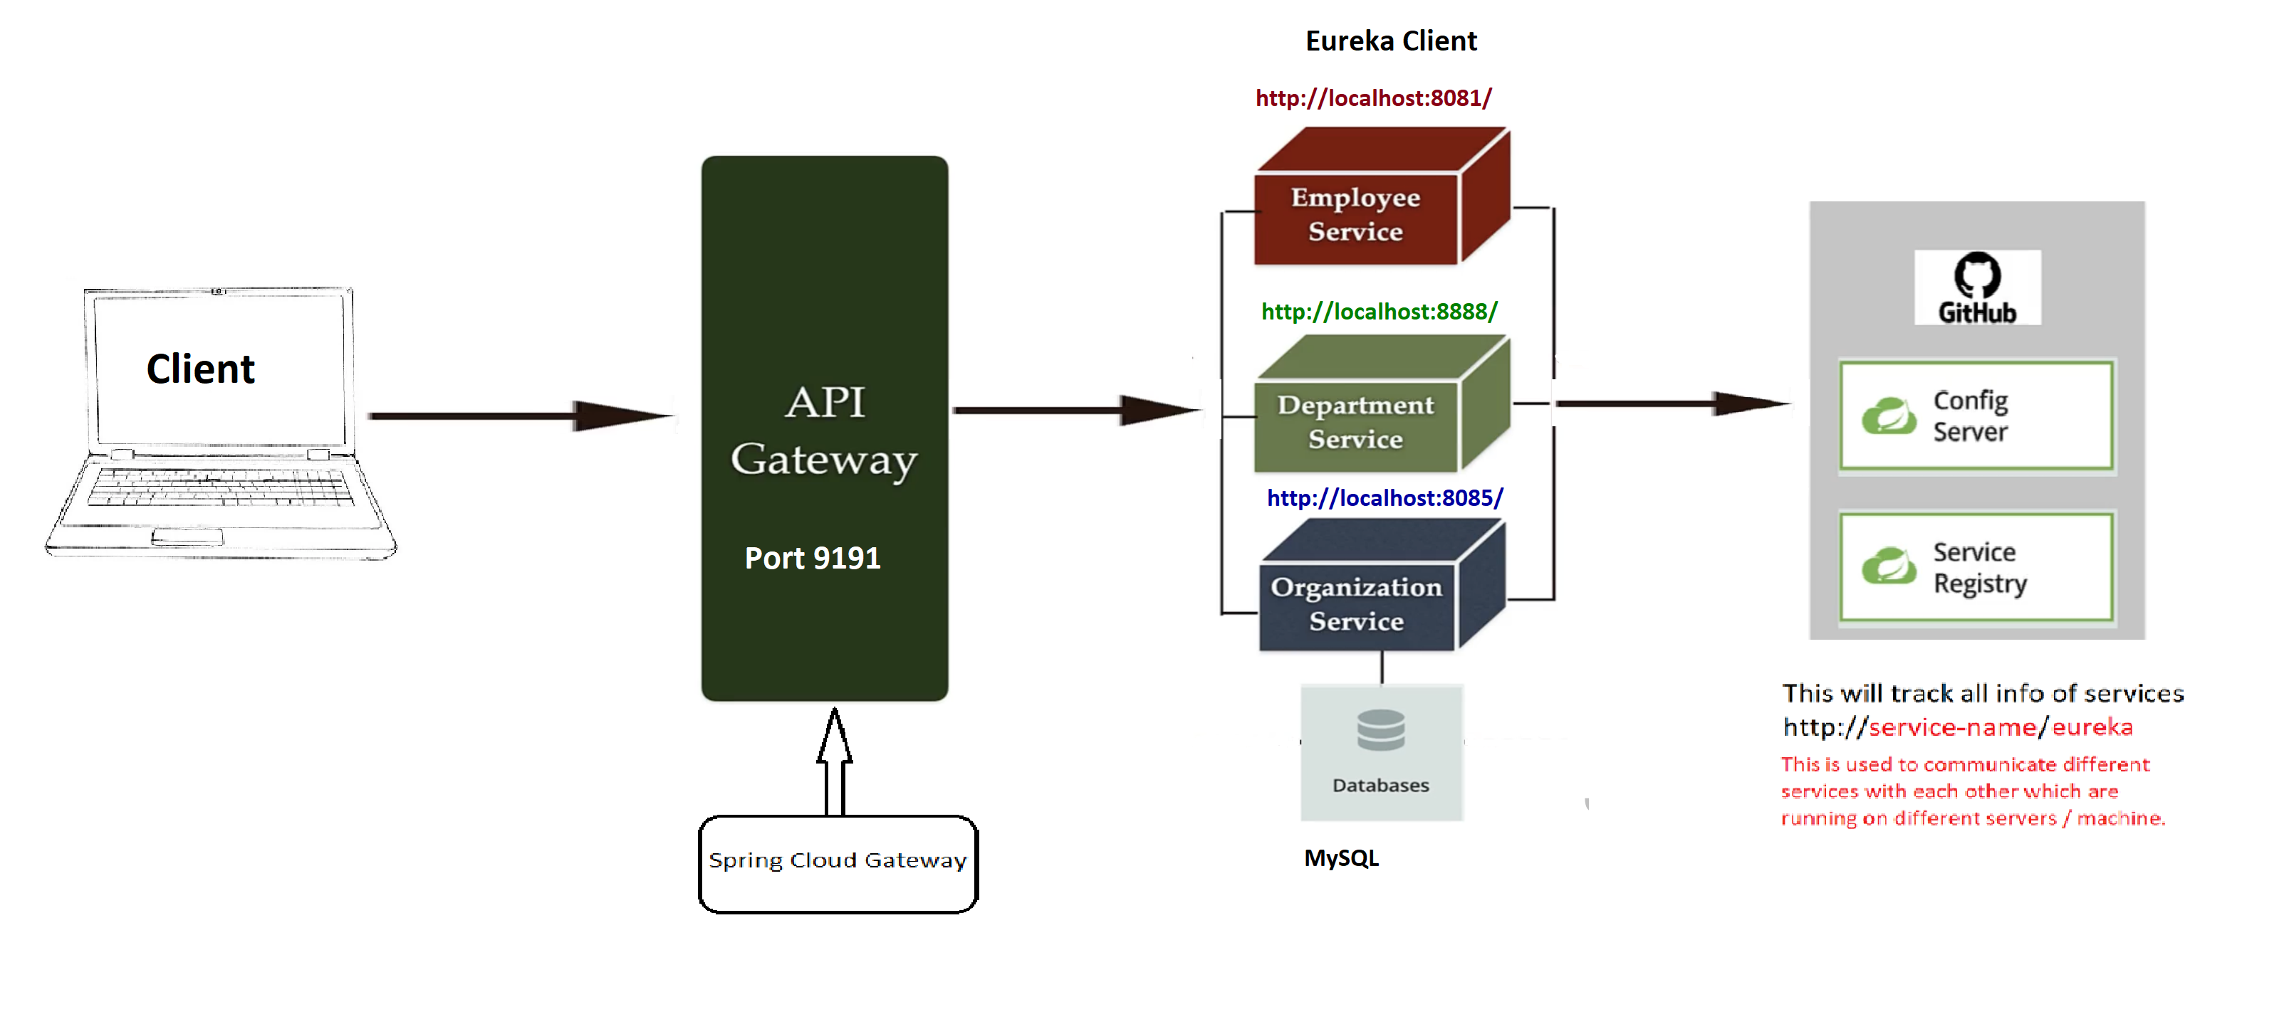
Architecture Diagram

Slide 7
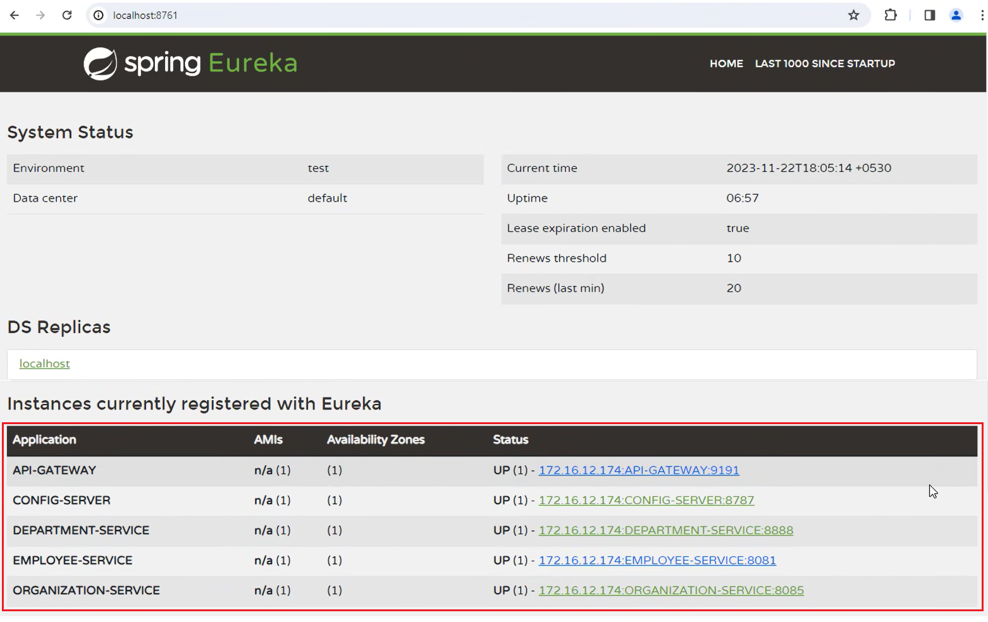
Spring Eureka Service Registry

Slide 8
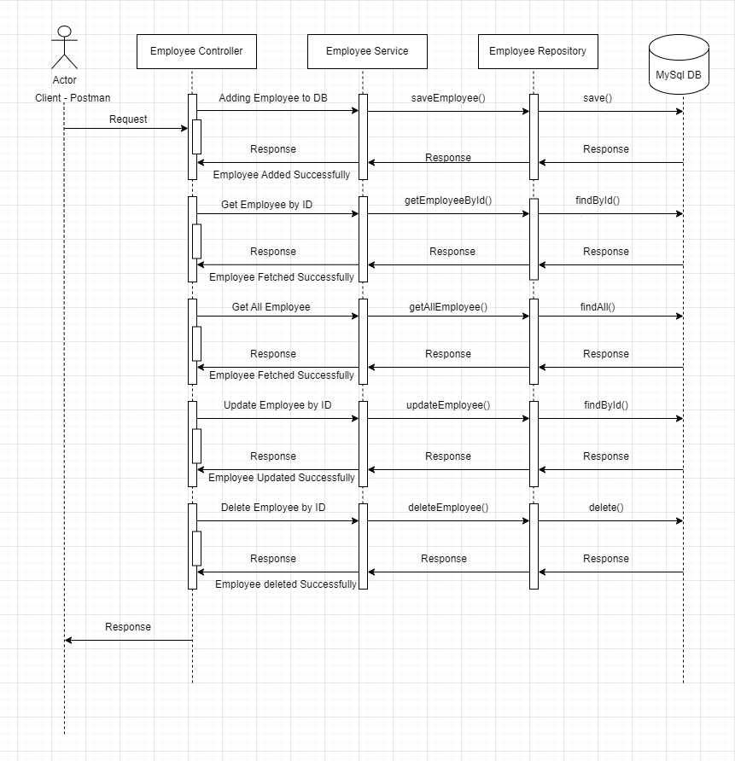
Sequence Diagram- Employee Module

Slide 9
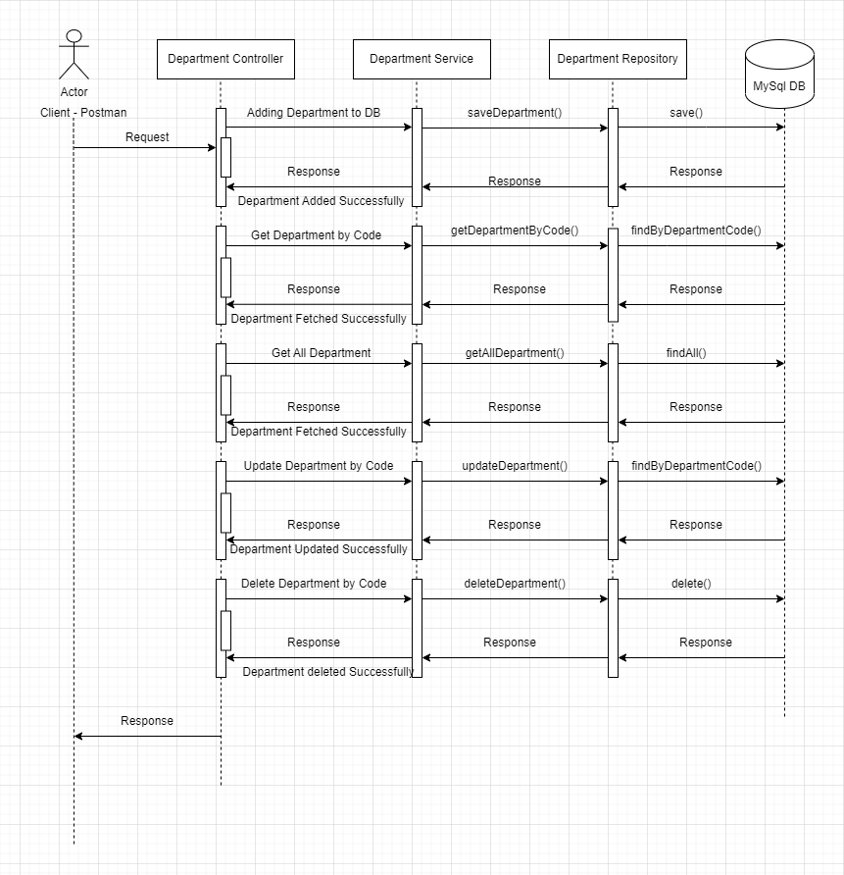
Sequence Diagram-Department Module

Slide 10
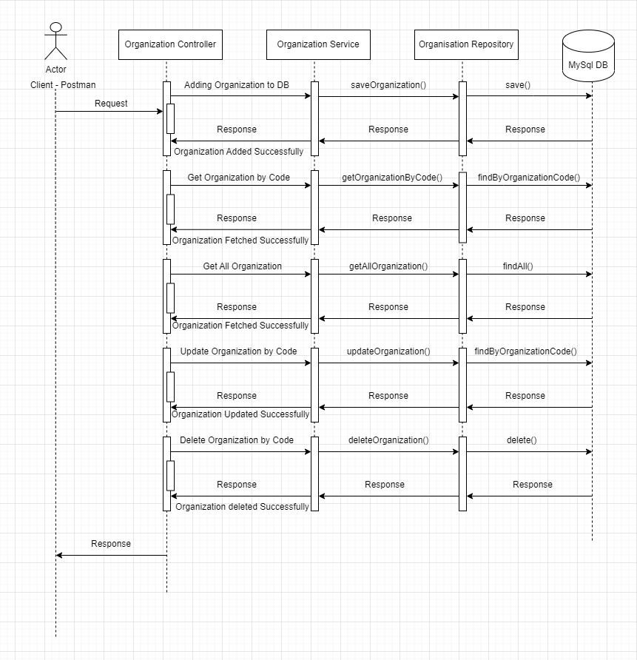
Sequence Diagram – Organization Module

Slide 11
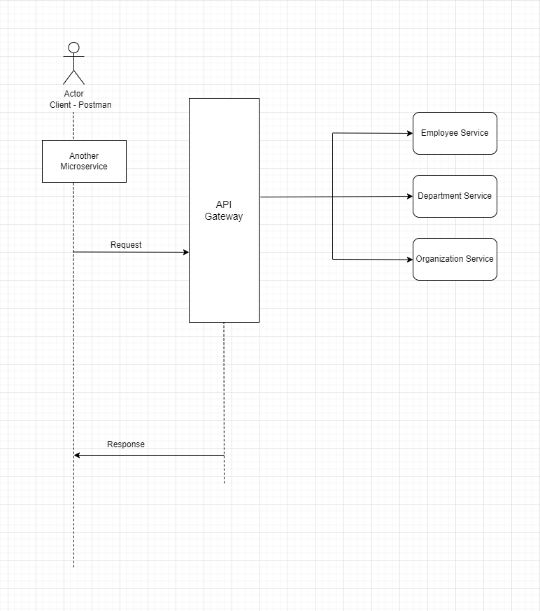
Sequence Diagram- API Gateway

Slide 12
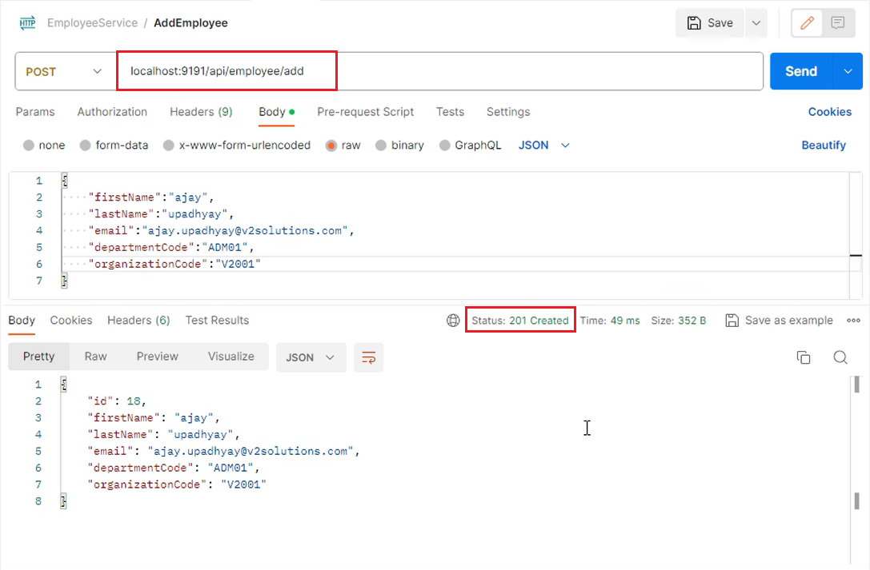
Outputs – Employee Module

Slide 13
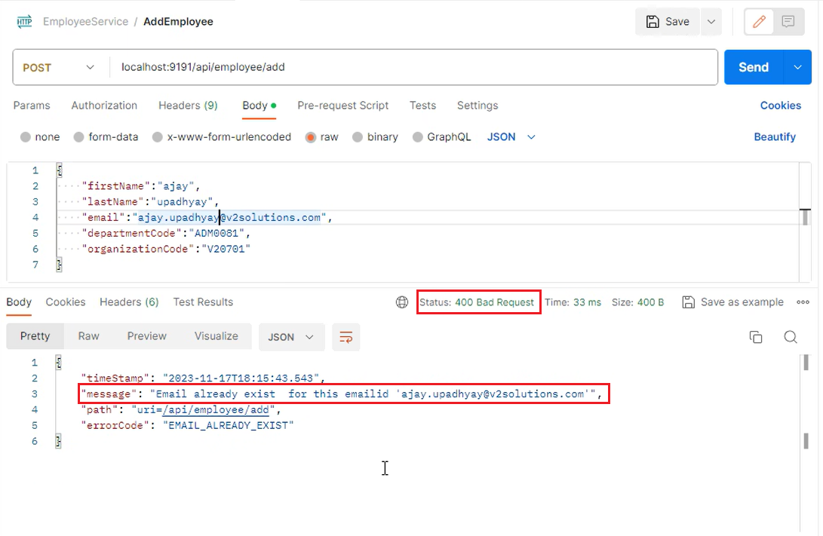
Outputs – Employee Module

Slide 14
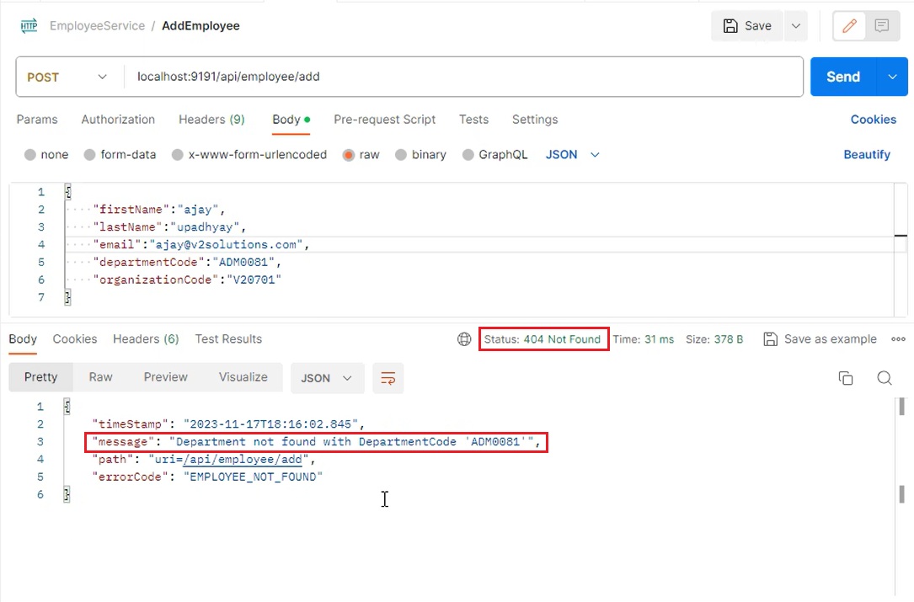
Outputs- Employee module

Slide 15
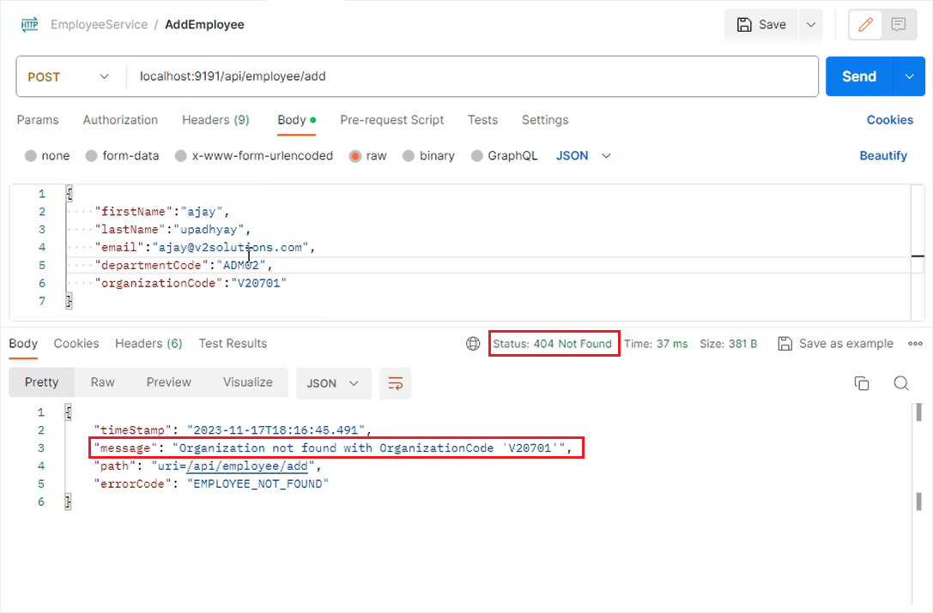
Outputs- Employee module

Slide 16
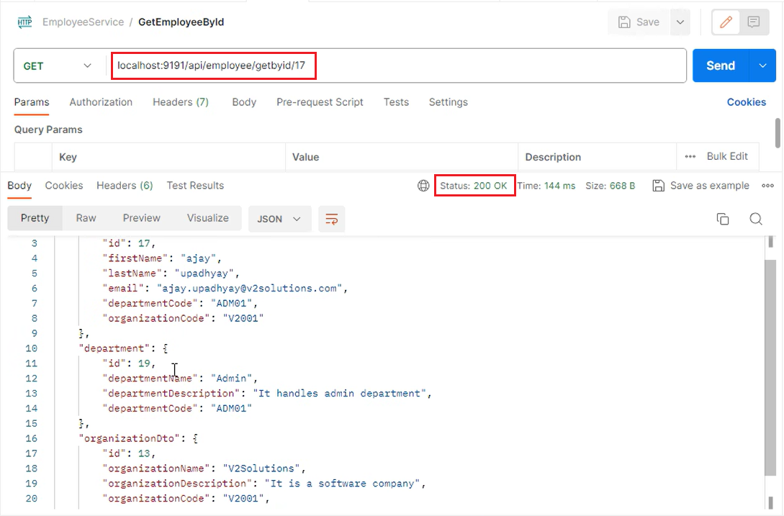
Outputs- Employee module

Slide 17
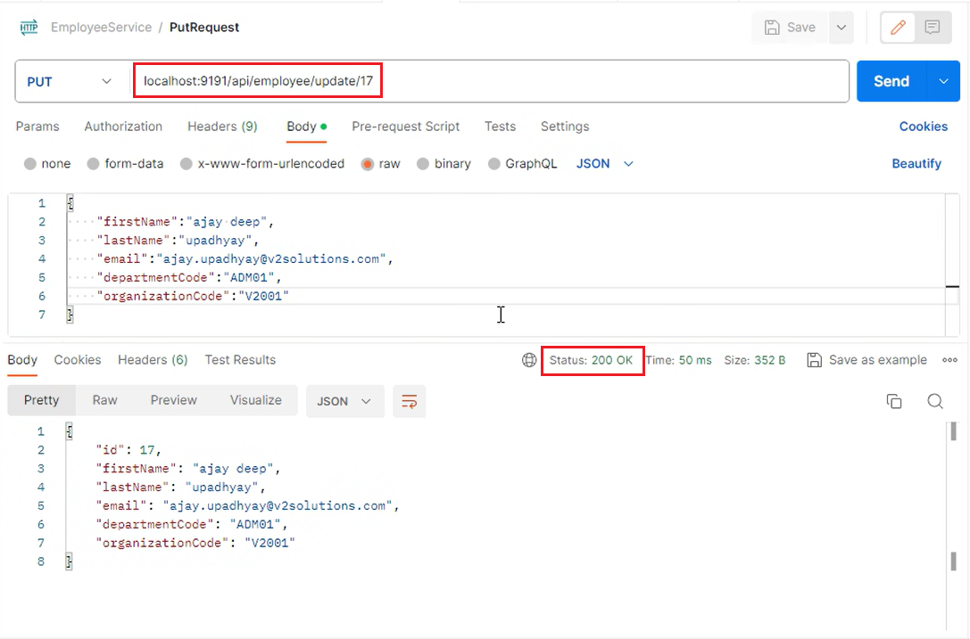
Outputs- Employee module

Slide 18
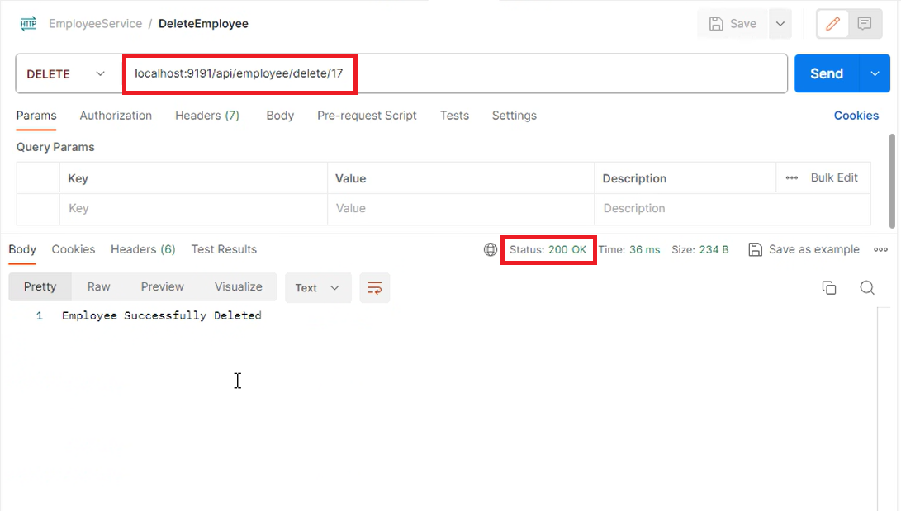
Outputs- Employee module

Slide 19
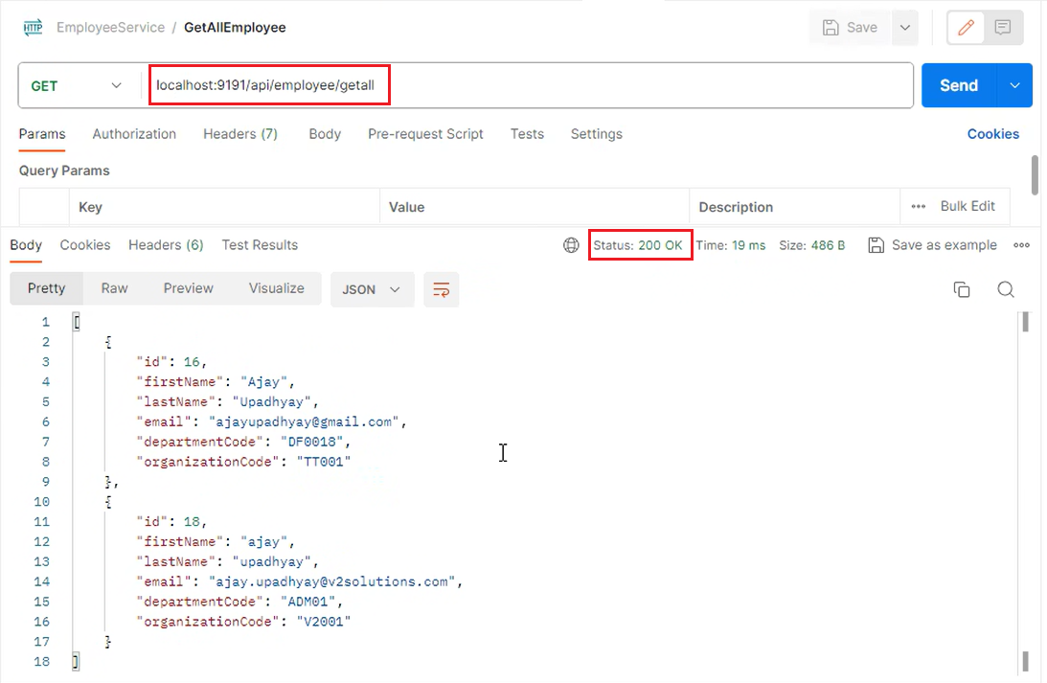
Outputs- Employee module

Slide 20
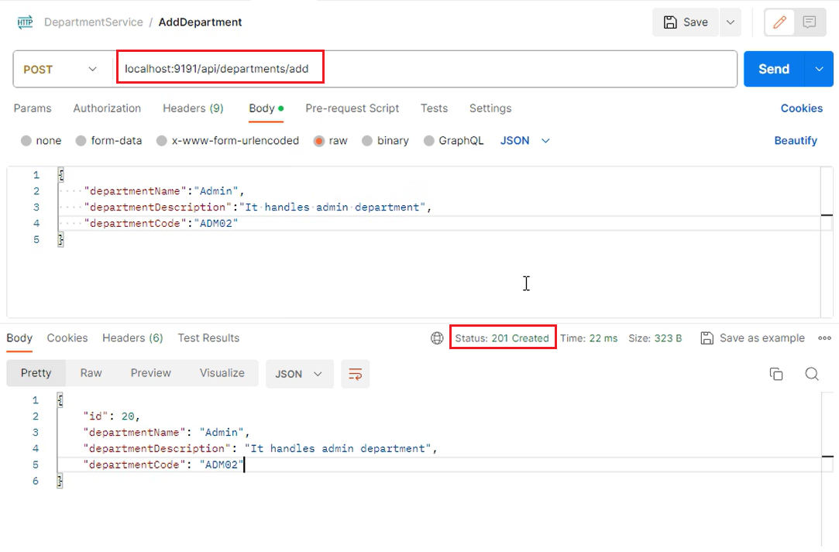
Output-Department module

Slide 21
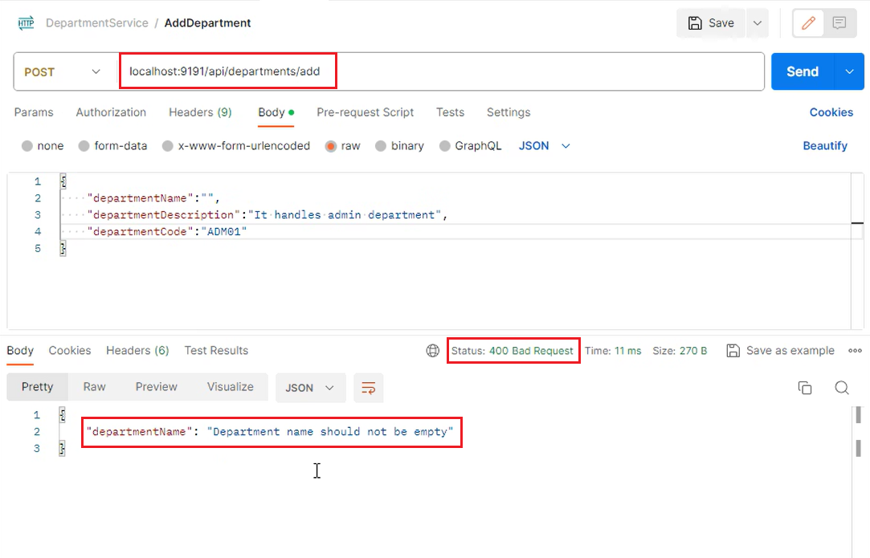
Output-Department module

Slide 22
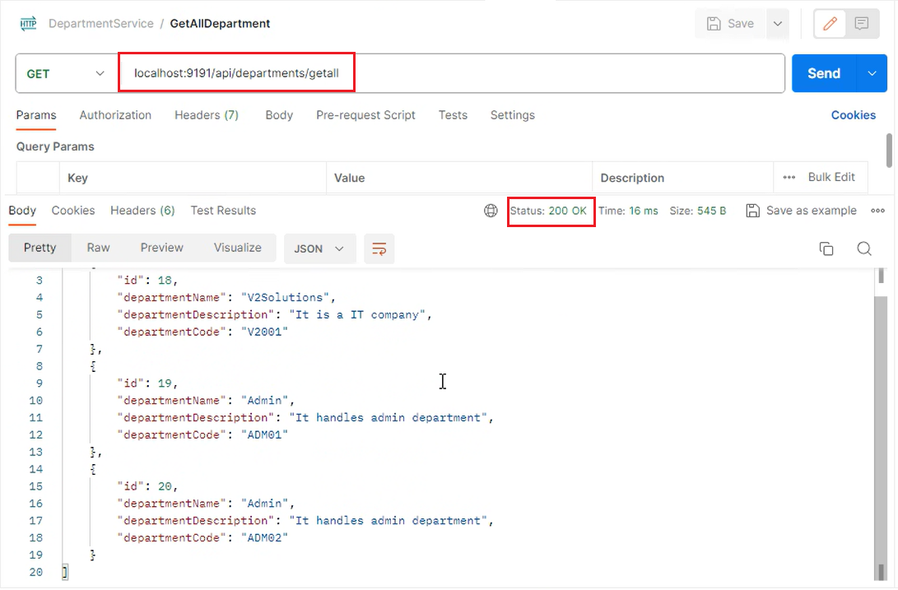
Output-Department module

Slide 23
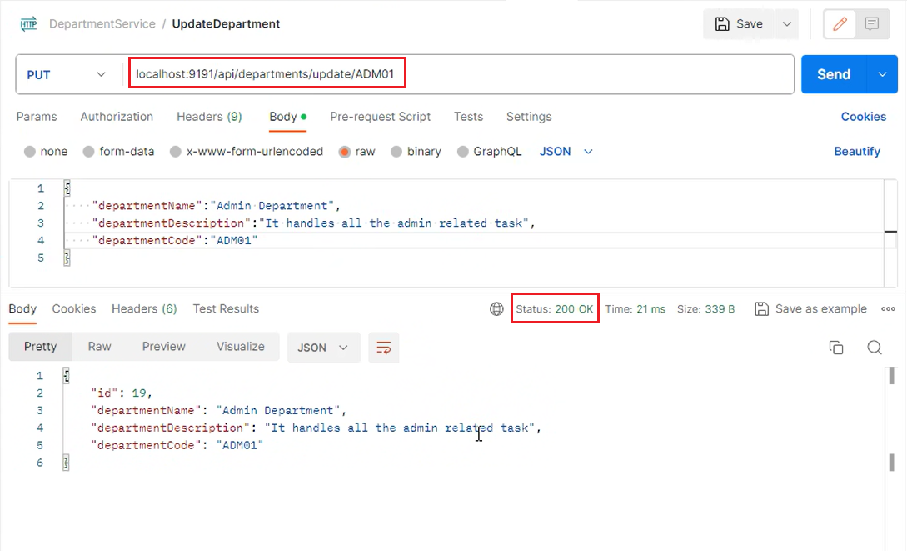
Output-Department module

Slide 24
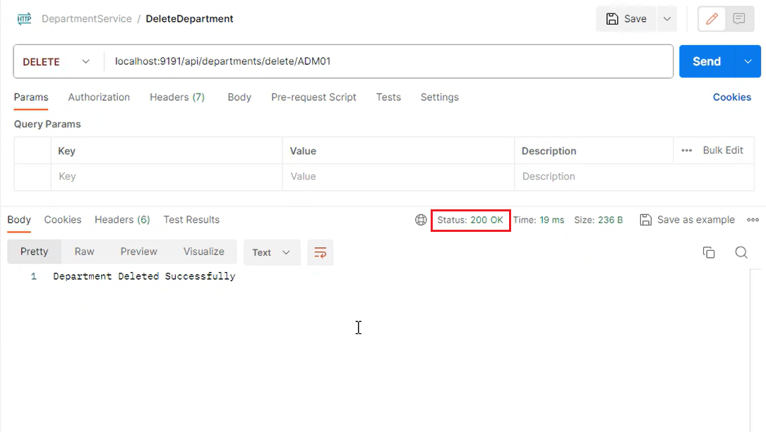
Output-Department module

Slide 25
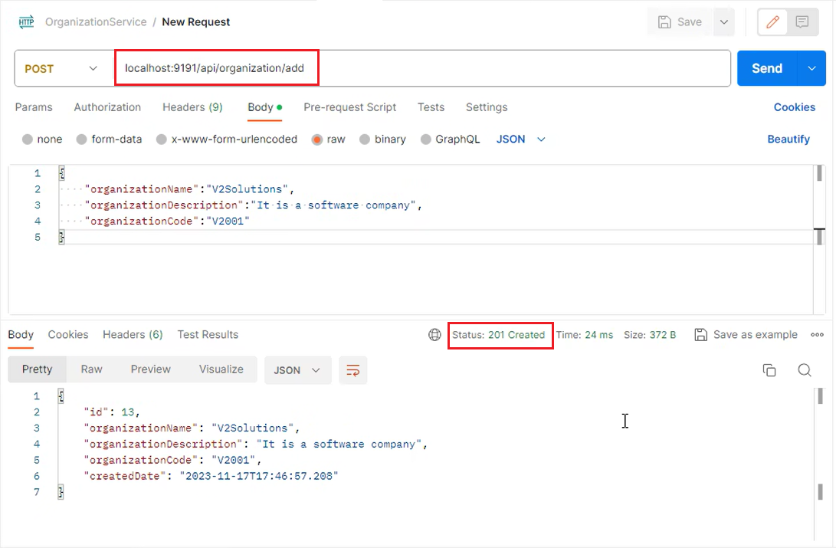
Output- Organization Module

Slide 26
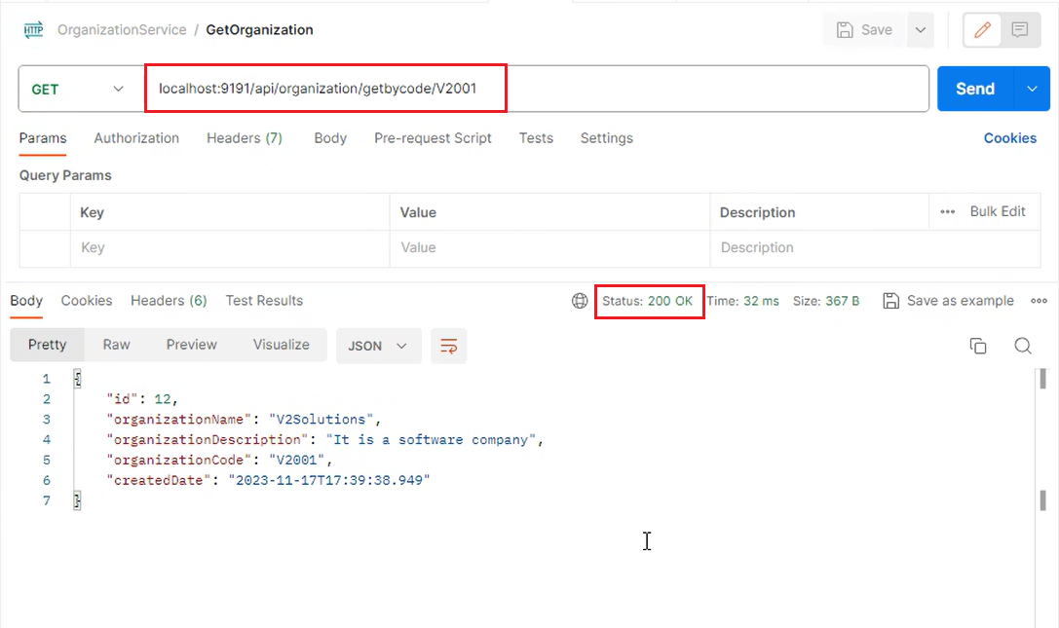
Output- Organization Module

Slide 27
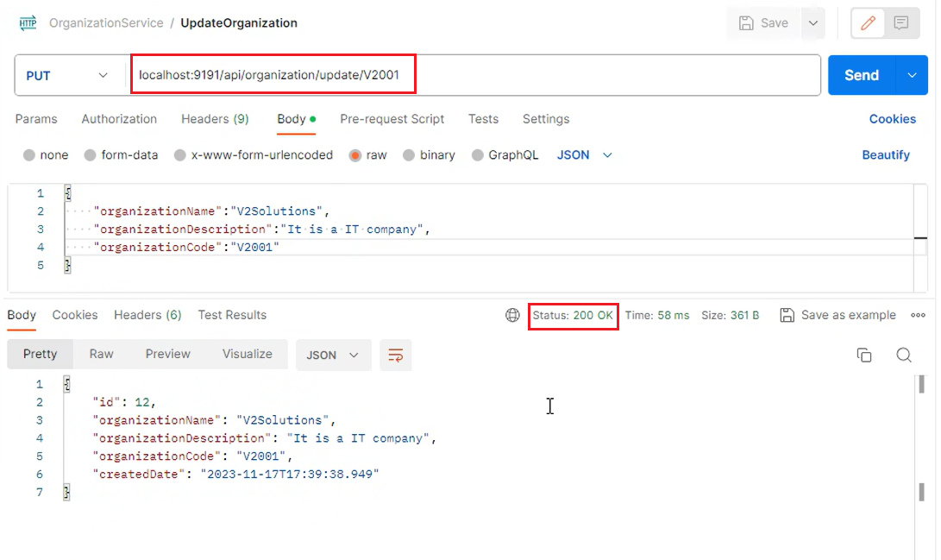
Output – Organization Module

Slide 28
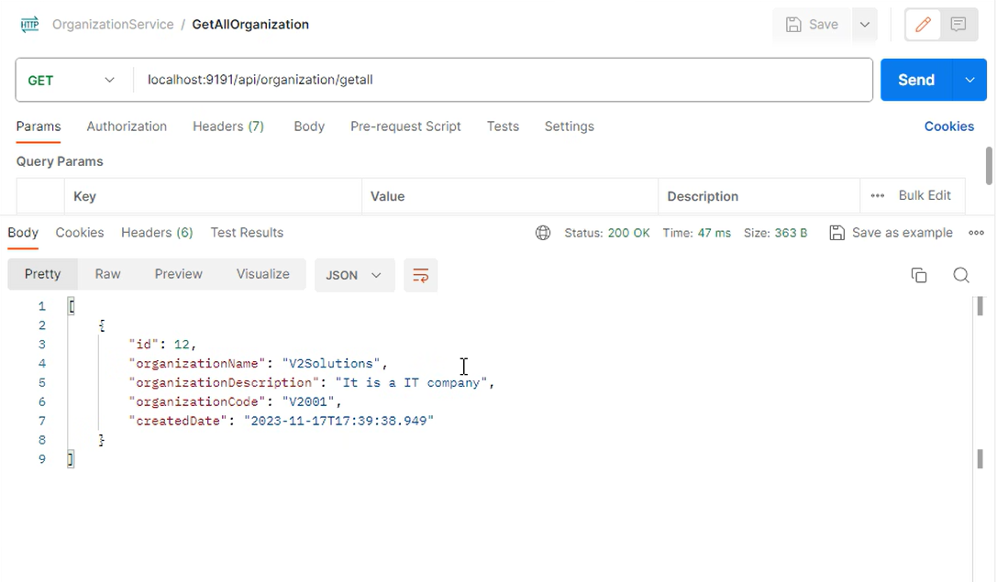
Output – Organization Module

Slide 29
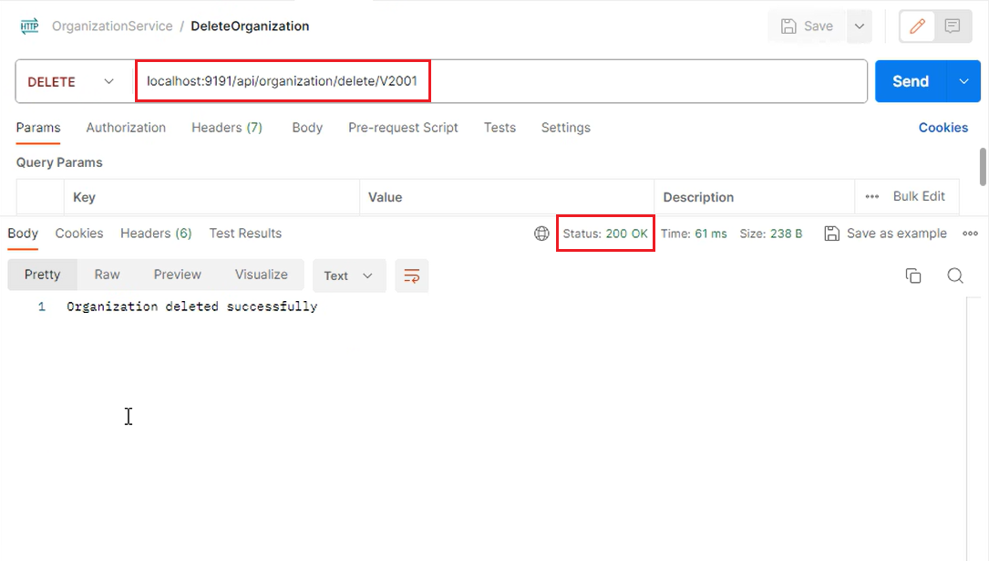
Output – Organization Module

Slide 30
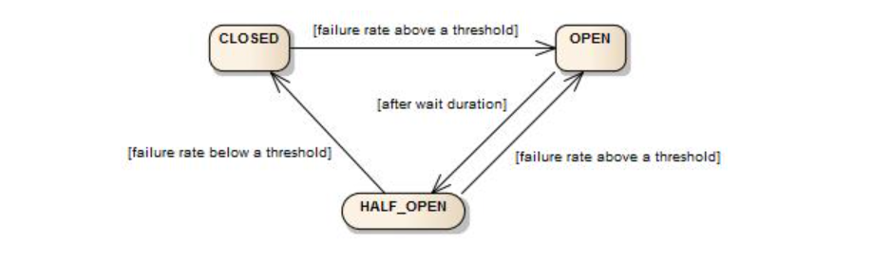
Circuit Breaker Architecture
The Circuit Breaker is implemented via a finite state machine with three normal states: CLOSED, OPEN and HALF_OPEN.

Slide 31
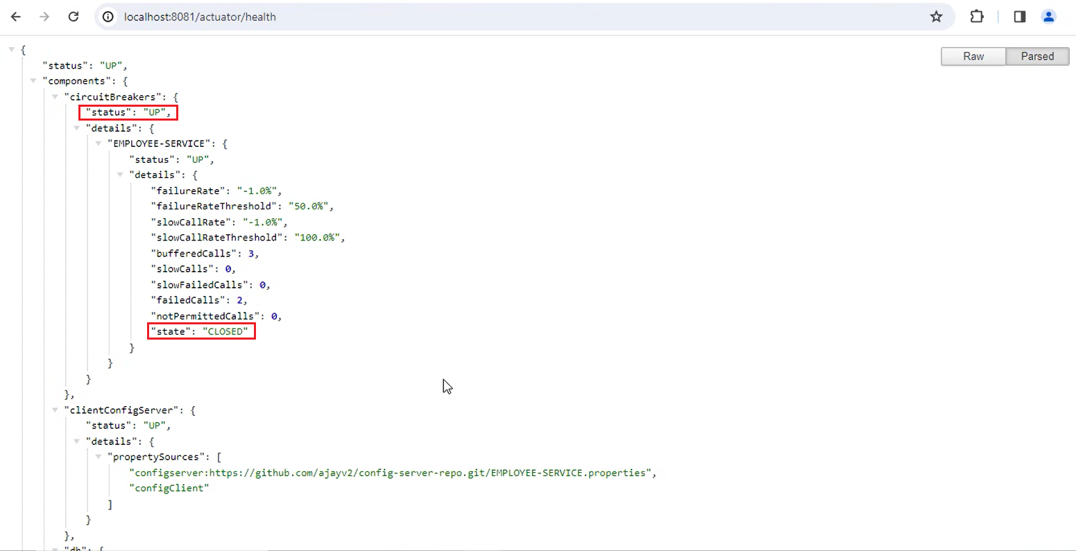
Output – Circuit Breaker Implementation

Slide 32
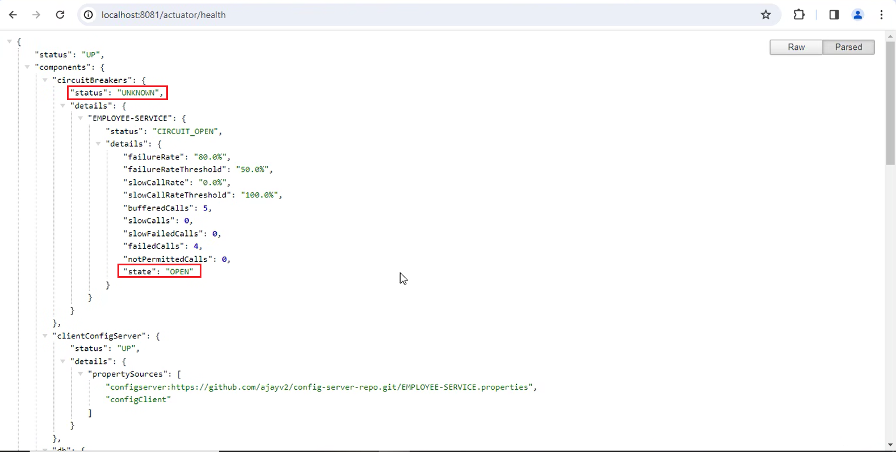
Output – Circuit Breaker Implementation

Slide 33
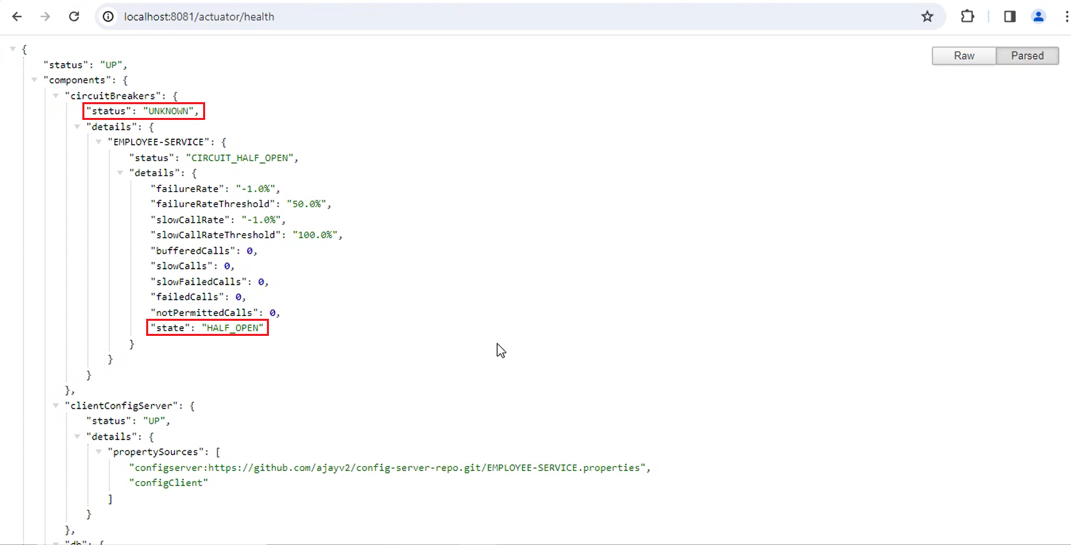
Output – Circuit Breaker Implementation

Slide 34
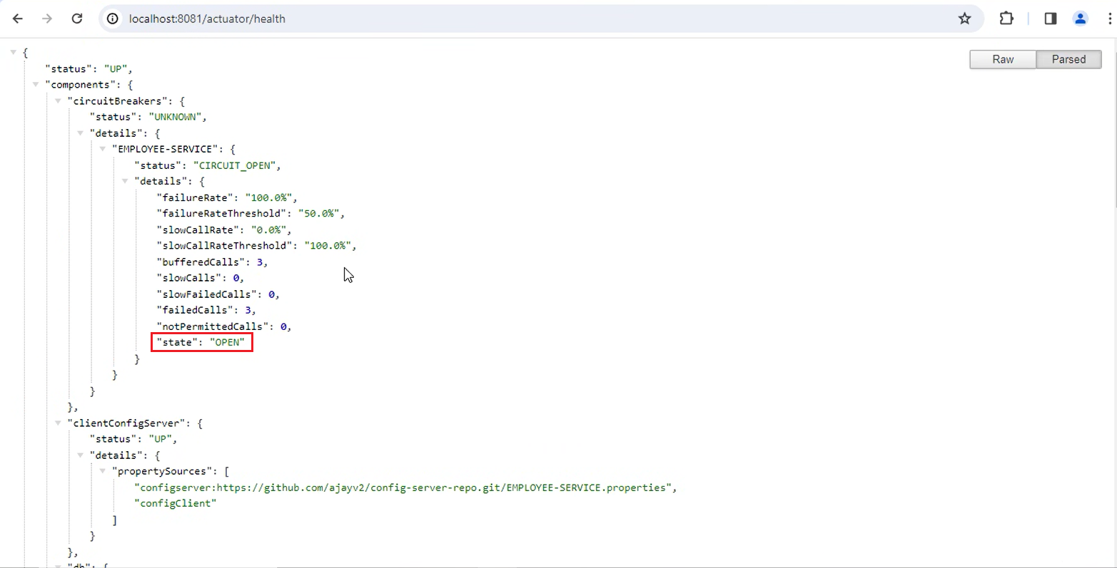
Output – Circuit Breaker Implementation

Slide 35
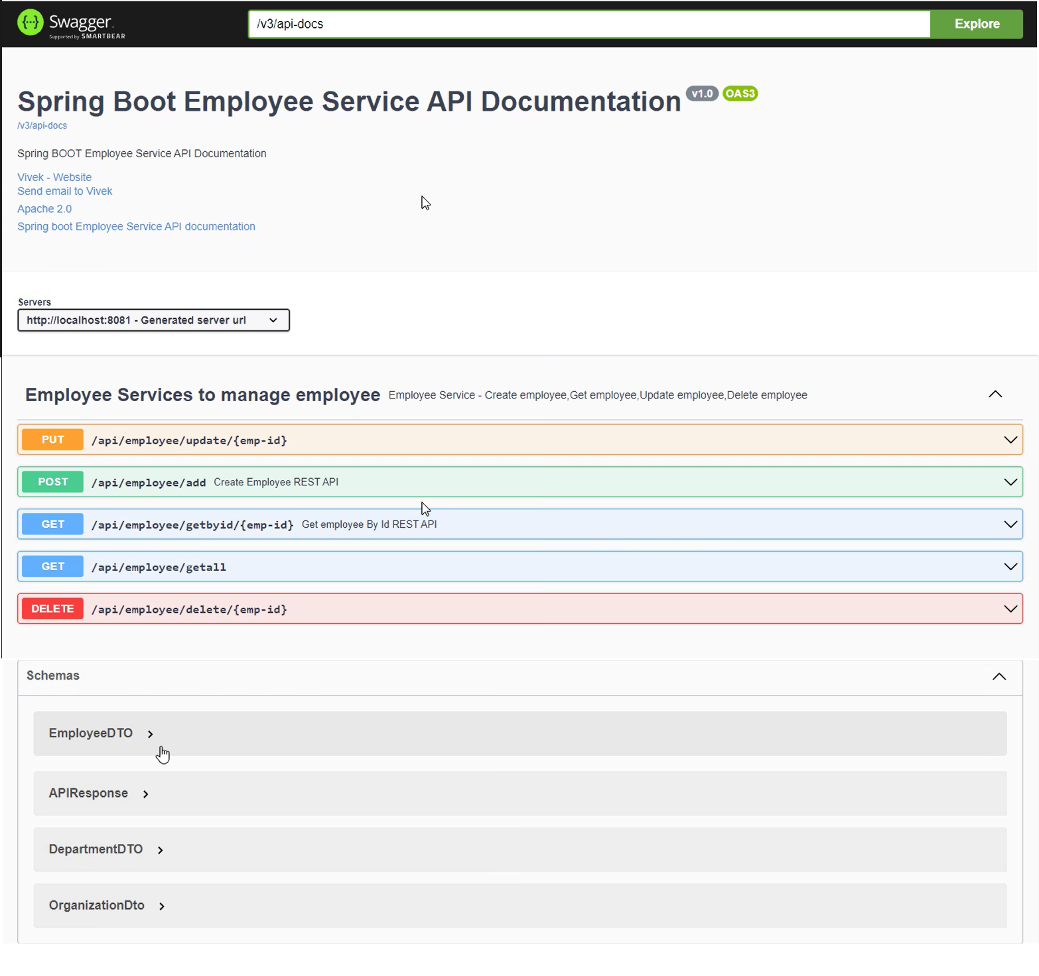
Swagger Implementation – Employee Service

Slide 36
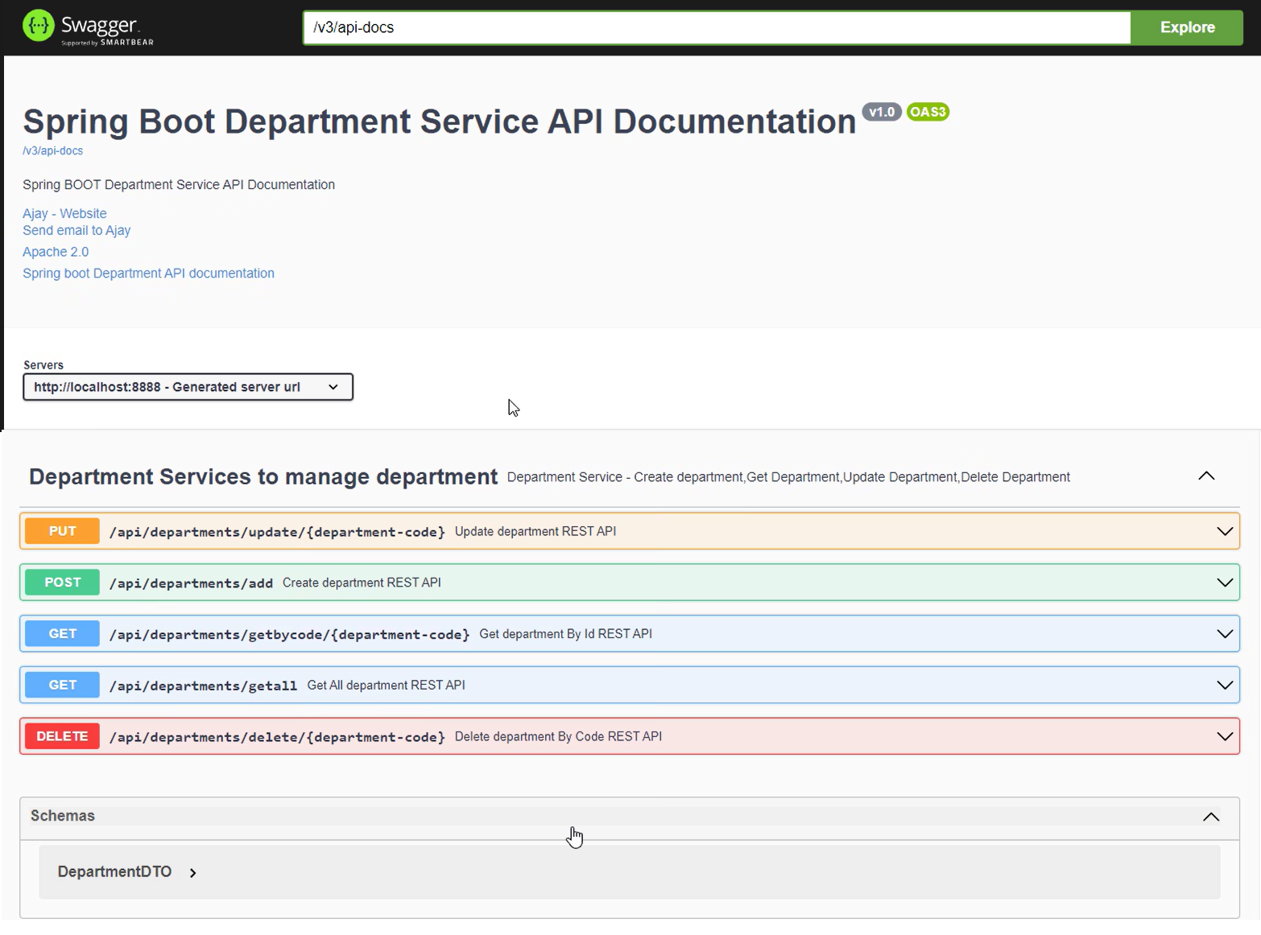
Swagger Implementation – Department Service

Slide 37
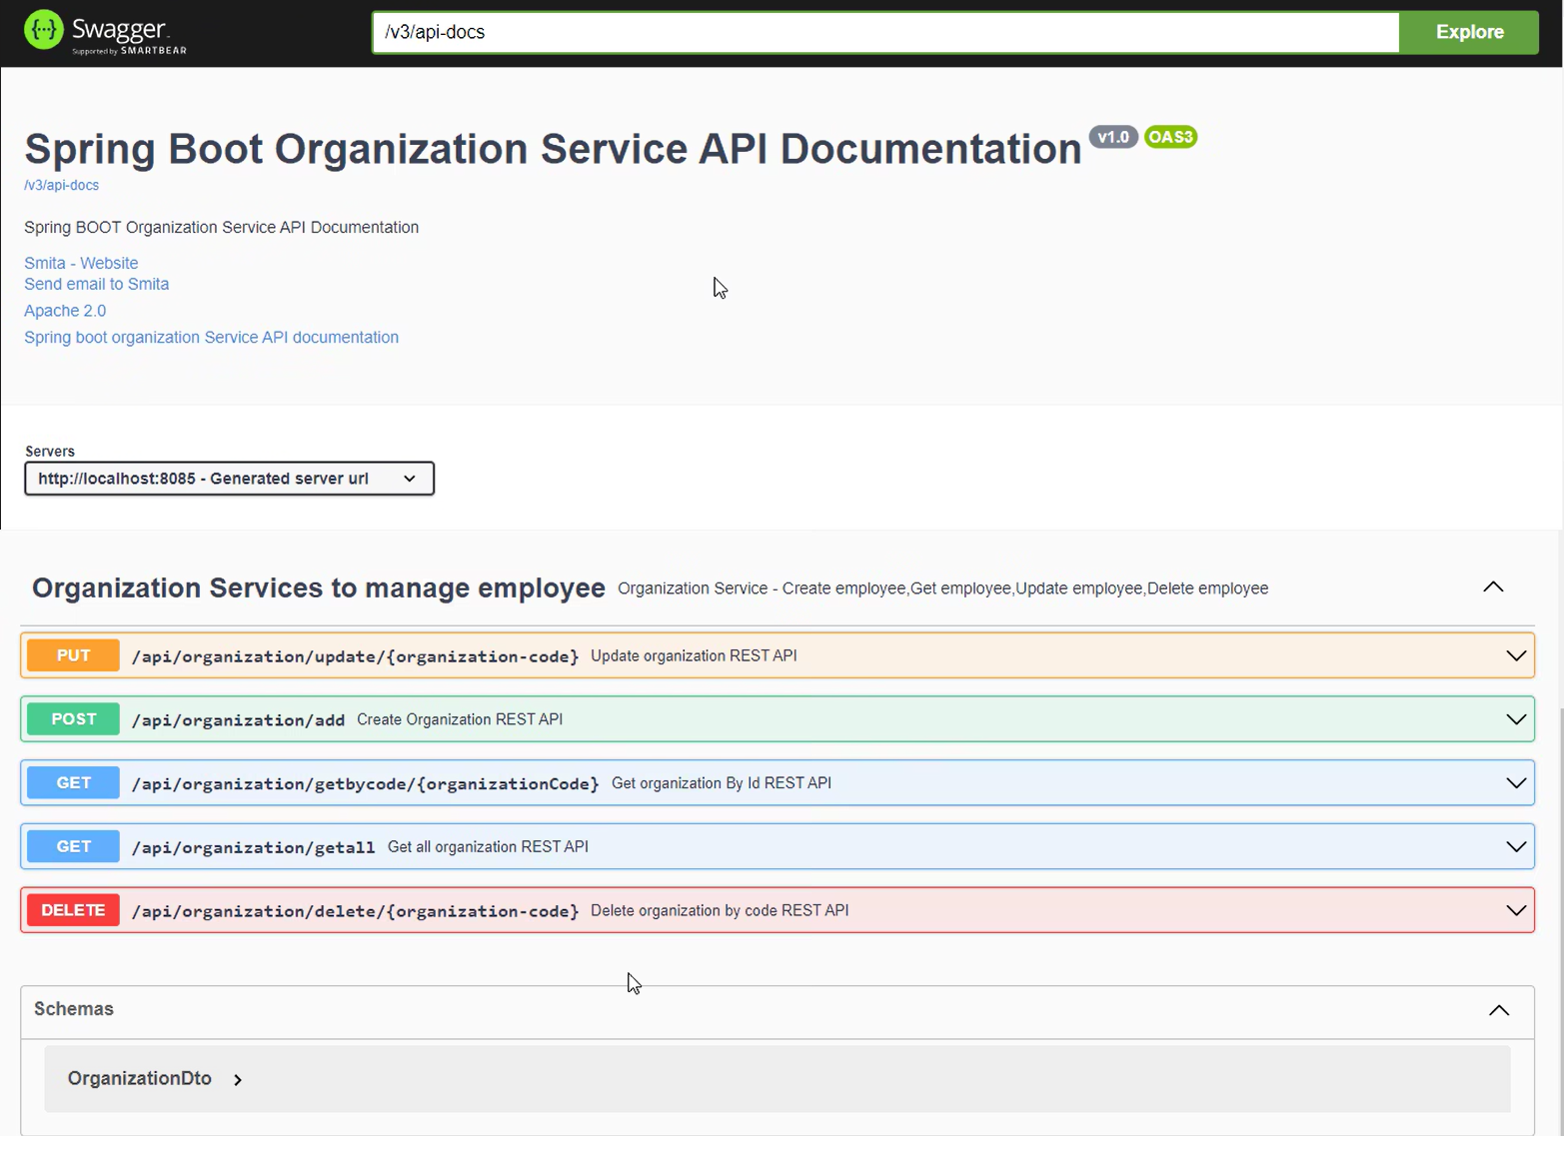
Swagger Implementation – Organization Service

Slide 38
Learnings
Spring Boot
Rest Api
Hibernate JPA
CRUD Operations
MVC Architecture
Microservices
Rest Template
Feign Client
Database-MySQL
Api Testing
Debugging
Deployment using Aws

Slide 39
Q&A

Slide 40
First Last
email@email
First Last
email@email

